Slide 1
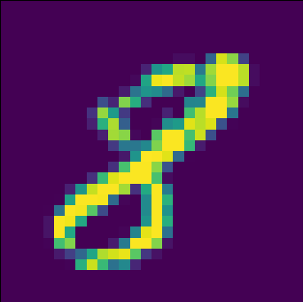
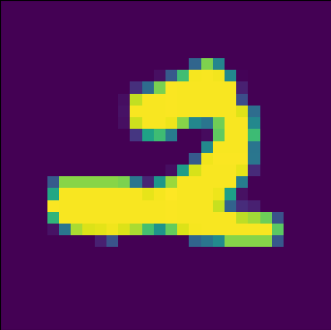
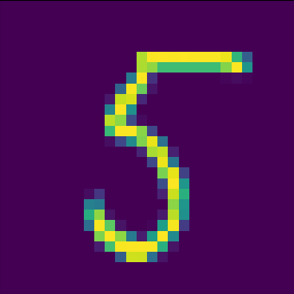
AI Project 2: Digit Classification Model
By: Wassim Al Haraki

Slide 2
Business Concept
OCR
Usages
Written digit classification model
MNIST dataset

Slide 3
Data Cleaning & Preprocessing
Cleaning labels
Image preprocessing:
- Read
- Resize
- Grayscale
- Divide by 255
- Reshape
- Split

Slide 4
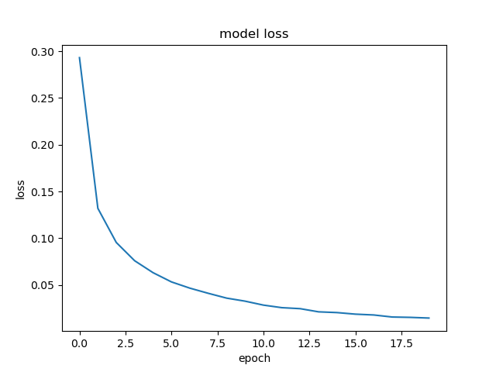
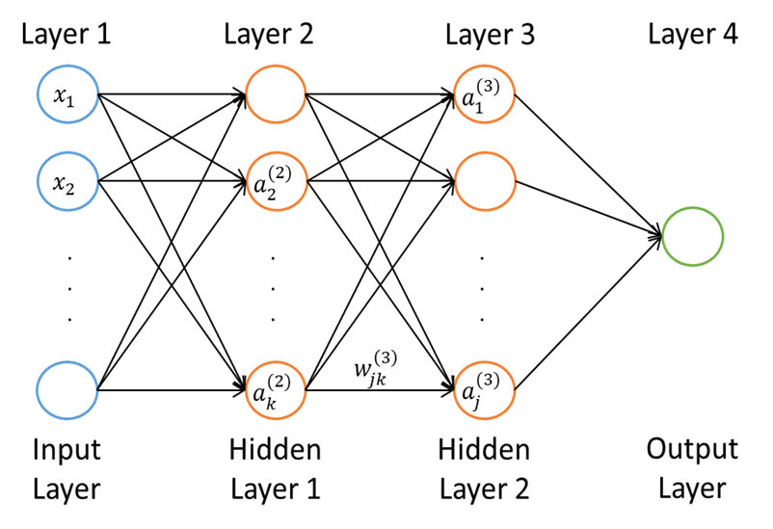
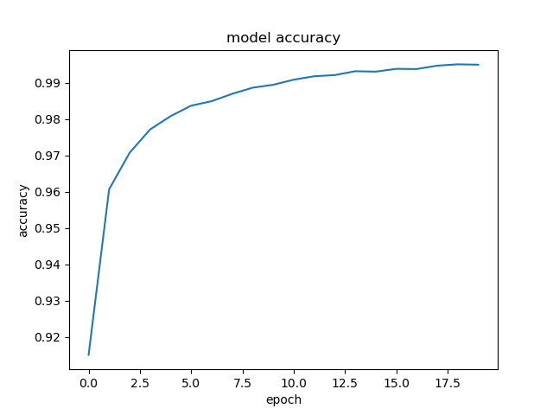
Model Building & Training
Build: 4 Layers;
- Input
- 2 Hidden
- Output
Train: 20 Epochs (9s/Epoch)
- Training accuracy: 99.5%

Slide 5
Experimenting
Testing accuracy: 97.6%
Predict individual images
Not enough
Issues?

Slide 6
Conclusion
What does this model provide?
- Building block
- Multi-digit classification models
wassimalharaki/Digit-Classification-Model (github.com)
Thank you!

